Slide 1
Laptop Request Catalog Item
NAAN MUDHALVAN PROJECT

Slide 2
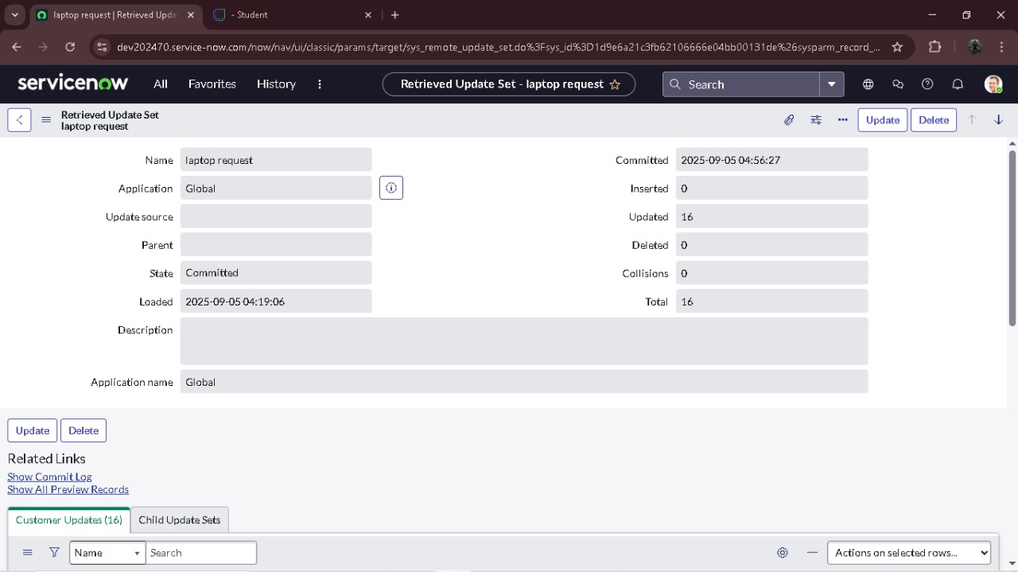
UPDATE SET
CREATES A LOCAL UPDATE SET
Open service now. Click on All >> search for update sets Select local update sets under system update sets Click on new Fill the following details to create a update set as: “Laptop Request” Click on submit and make current By clicking on the button it activates the update set .

Slide 3

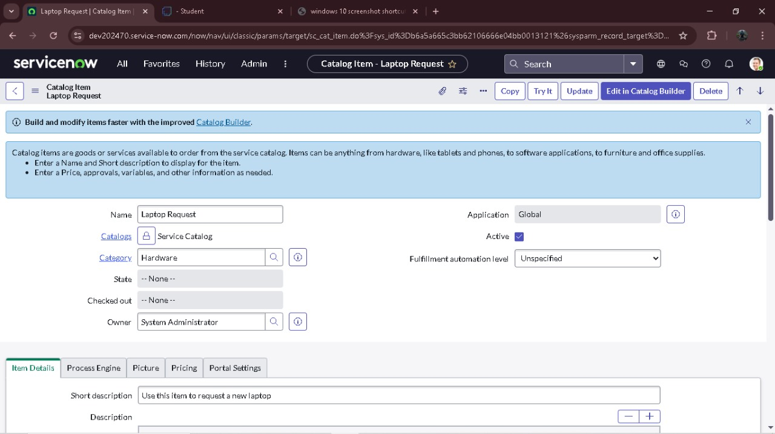
Create Service Catalog Item
Open service now. Click on All >> service catalog Select maintain items under catalog definitions Click on New.
Fill the following details to create a new catalog item Name: Laptop Request Catalog: service Catalog
Category: Hardware
Short Description: Use this item to request a new laptop Click on ‘SAVE’

Slide 4

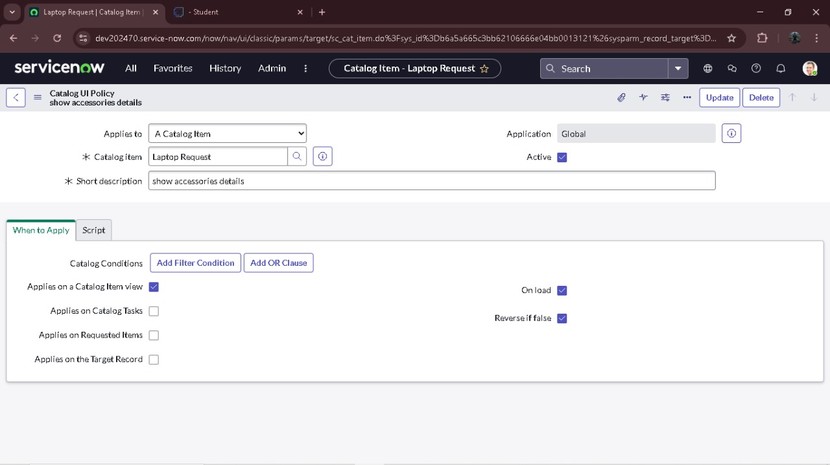
Create Catalog Ui policies
Click on all>> search for service catalog Select maintain item under catalog definition Search for ‘laptop request’ which is created before Select ‘laptop request’ and scroll down click on “Catalog Ui policies” In the catalog ui policies related list tab click on new Give short description as: show accessories details Set the Catalog Condition in the related list tab ‘when to apply’ [field: additional_ accessories, operator: is, value: true]

Slide 5
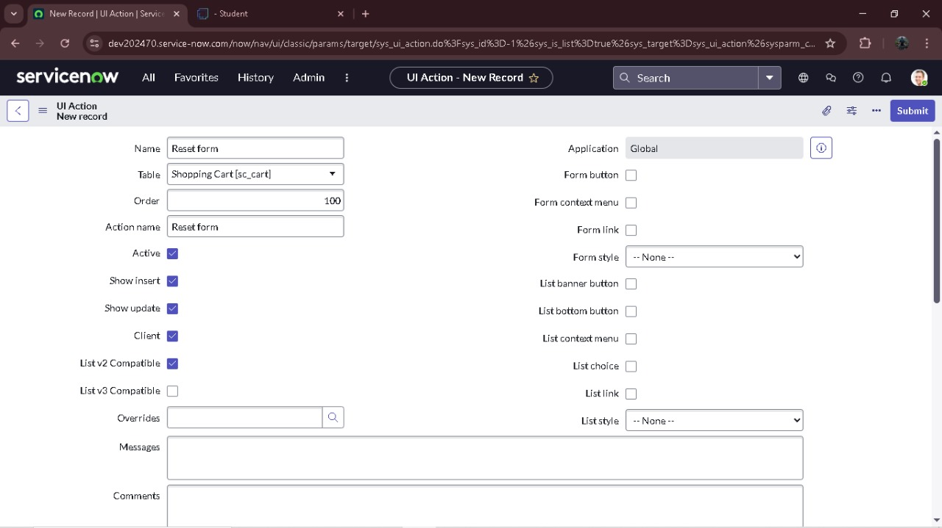
Create ui action
Open service now. Click on All >> search for ui action Select ui actions under system definition Click on new Fill the following details to create ui action Table: shopping cart(sc_cart) Order:100 Action name: Reset form Client : checked

Slide 6
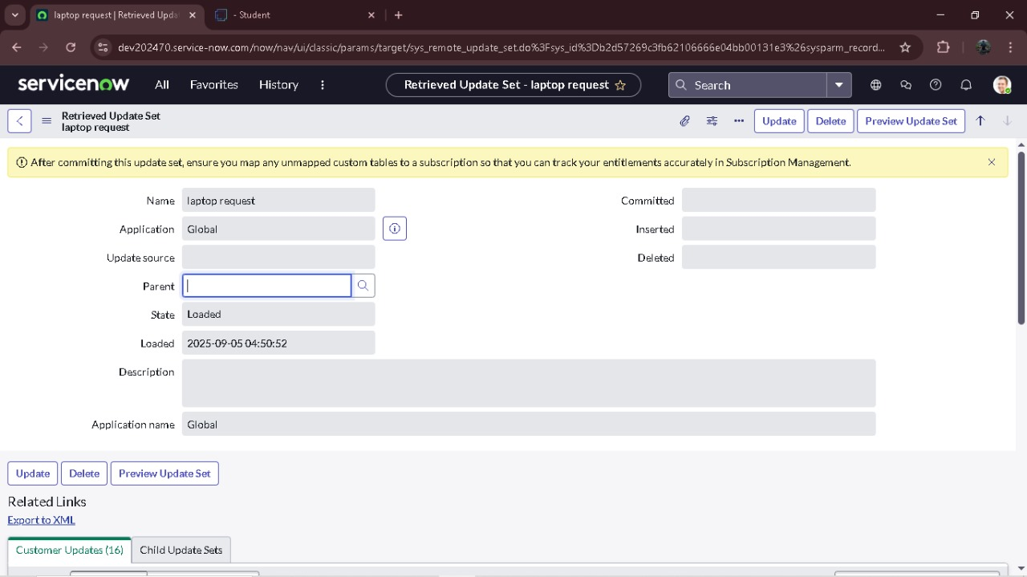
Exporting changes to another instances
Click on All >> search for update sets Select local update set Select created update set i.e. ‘Laptop Request Project’ Set the state to ‘Complete’ In the related list Update tab, updates are visible which we perform under this update set. Click on export to XML ,it download one file

Slide 7
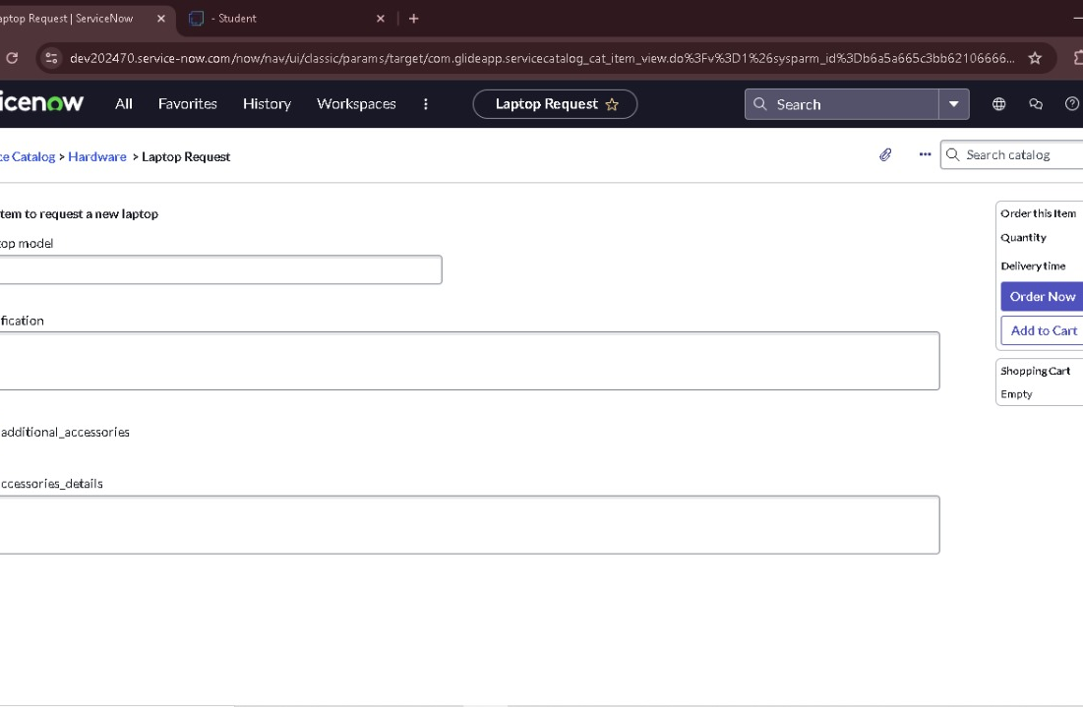
Retrieving the update set
Open another instance in incognito window Login with credentials Click on all>> search for update sets Select “Retrieved update set” under system update set It open retrieved update set list and scroll down Click on Import update set from XML
Upload the downloaded file in XML file Click on Upload and it gets uploaded.

Slide 8
Test Catalog Item
Upload the downloaded file in XML file Click on Upload and it gets uploaded.Search for service catalog in application navigator in target instance Select catalog under service catalog Select hardware category and search for ‘laptop request’ item Select laptop request item and open it It shows three variables only

Slide 9
CONCLUSION
The Laptop Request Catalog Item project successfully streamlines the process of requesting laptops within the organization by leveraging ServiceNow’s Service Catalog capabilities. Through the implementation of a dynamic catalog item, the project ensures that users have an intuitive and user-friendly interface, reducing errors and improving efficiency.This project demonstrates how ServiceNow can be used to replace manual, error-prone processes with automated, efficient, and user-centric solutions. It not only improves service delivery but also enhances employee satisfaction by providing a modern and streamlined request experience.

Slide 10
Laptop Request Catalog Item
Laptop Request Catalog Item Problem Statement: Employees in the organization need a quick and efficient way to request laptops for work.
IT WILL BE DONE BY
TEAM LEADER : TAMIL ARASU .R
TEAM MEMBER 1:YUGA BHARATHI
TEAM MEMBER 2: SELVA RAJ
TEAM MEMBER 3: SARAVANAN

